Slide 1
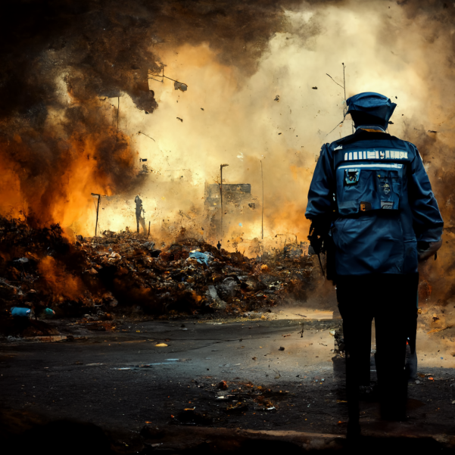
A Inteligência artificial e perigosa? Devemos Preocupar? Mas se a mesma for OpenSource?
#ptBr

Slide 2

Is artificial intelligence dangerous? Should We Worry? But if it is OpenSource?
#en-US

Slide 3


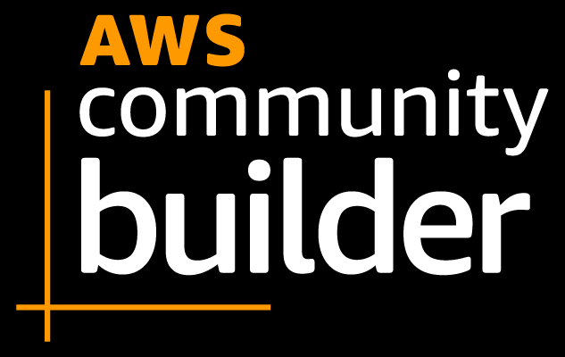







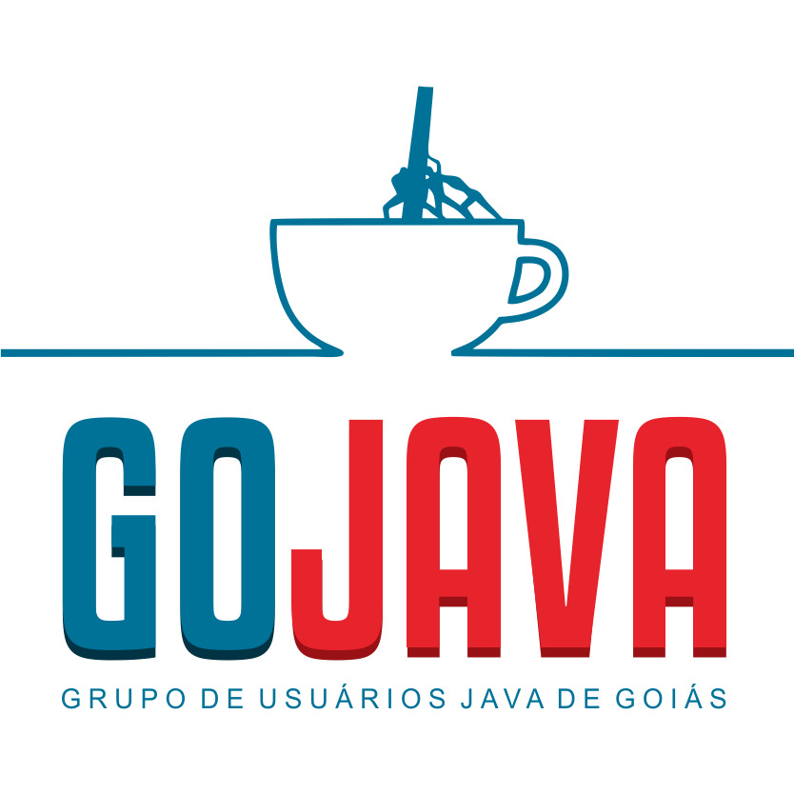

About the Speaker
Weder Mariano de Sousa
Specialist Senior Java - GFT
Technician System Development
Graduated Computer Science
https://www.linkedin.com/in/wedermarianodesousa/
Post Graduate in Midias UFG
https://github.com/weder96
Post Graduate in Information Security
https://twitter.com/weder96
https://dev.to/weder96
GOJava
AWS User Group Goiânia

Slide 4


Agenda
1. Is artificial intelligence dangerous?
2. Should We Worry?
3. But if it is OpenSource?

Slide 5

Introduction

Slide 6

Prerequisites and Tools

Slide 7
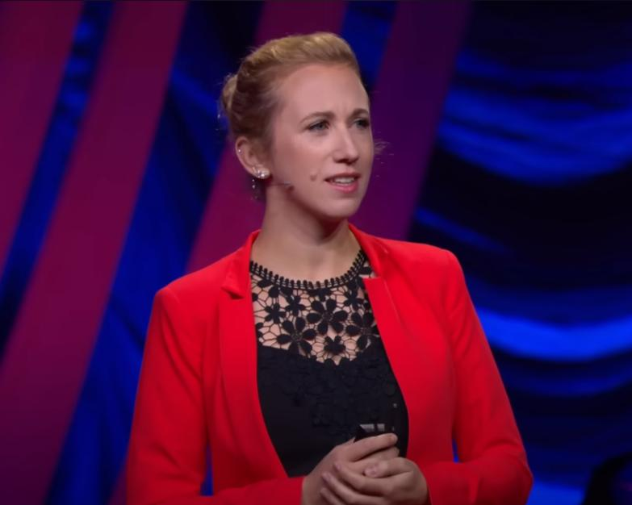
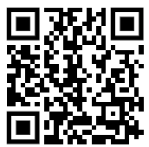
AI Is Dangerous, but Not for the Reasons You Think
Sasha Luccioni
https://www.youtube.com/watch?v=eXdVDhOGqoE

Slide 8

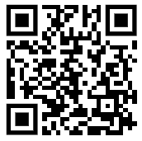
Efeito da IA:
Data centers Effect of AI:
data centers could
double energy
consumption by 2026.
https://www.youtube.com/watch?v=SslwA1CGc9A

Slide 9
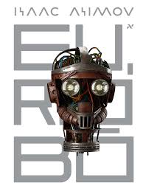
BOOK
I ROBÔ

Slide 10
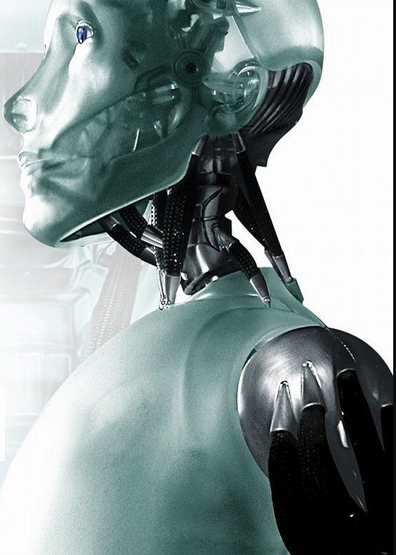
Three Laws of Robotics
The First Law:
A robot may not injure a human being or,
through inaction, allow a human being to come
to harm
The Second Law:
A robot must obey the orders given it by human
beings except where such orders would conflict
with the First Law.
The Third Law:
A robot must protect its own existence as long
as such protection does not conflict with
the First or Second Law

Slide 11
Zeroth Law
A robot may not injure humanity or,
through inaction, allow humanity
to come to harm.

Slide 12
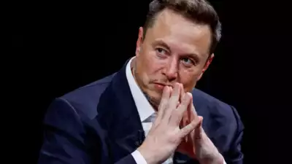
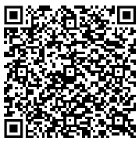
“I think it's probably….”: Elon Musk on when AI will become ..
“If you define AGI (artificial general intelligence)
as smarter than the smartest human,
I think it's probably next year, within two years,
” Musk said when asked about the
timeline for development of AGI.
https://timesofindia.indiatimes.com/technology/tech-news/

Slide 13
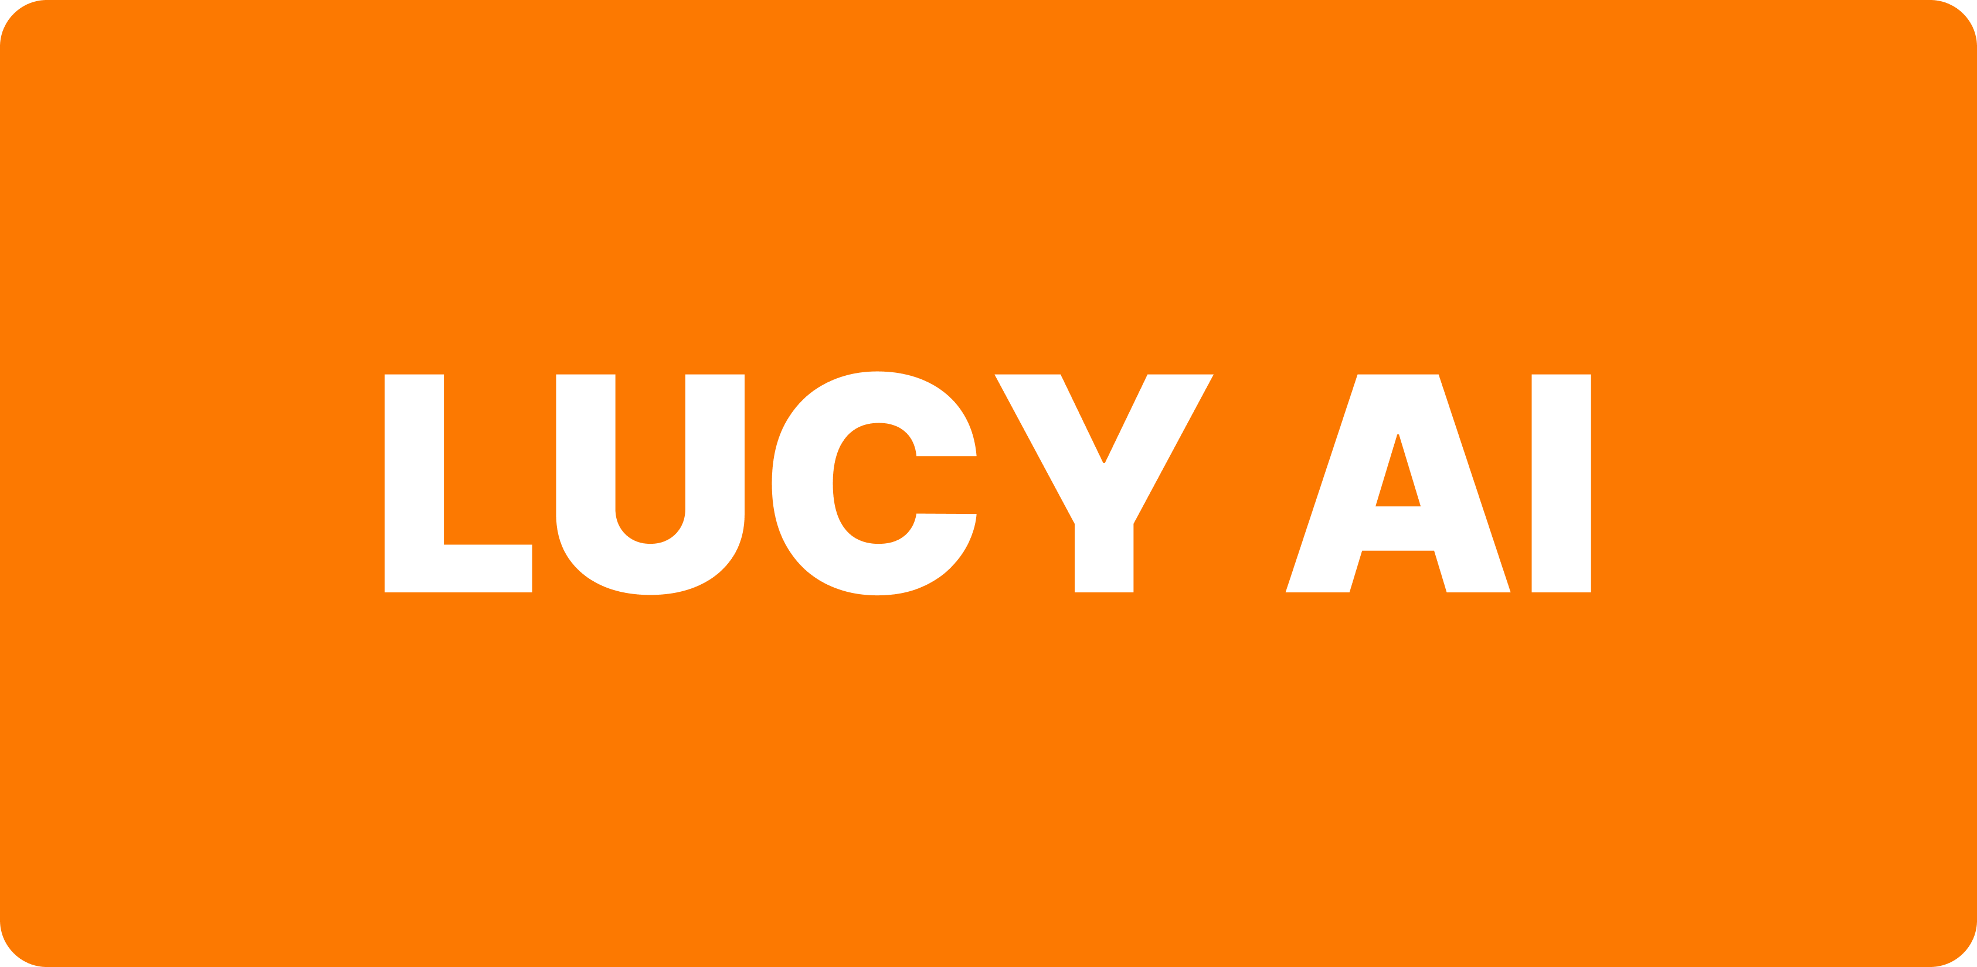
NENHUM DESENVOLVEDOR DEVERÁ SOFRER COM TESTES NA SUA VIDA
Artificial General Intelligence (AGI)

Slide 14

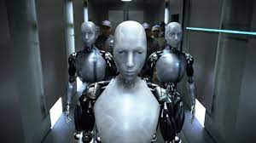
Artificial Intelligence is hunting and killing test analysts all over the world, chaos is
reigning in all countries, in Brazil there are already test analysts resigning
Artifial

Slide 15

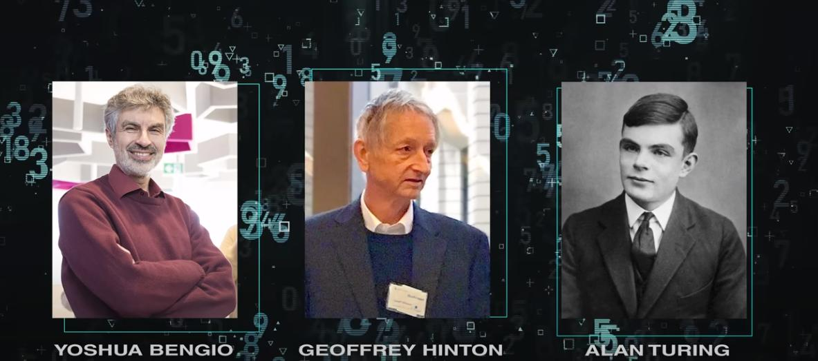
ALIGNED AI == CATASTROPHE == AN OPPORTUNITY

Slide 16
O problema associado à construção de sistemas de inteligências
artificiais poderosos que são alinhados com seus operadores
Artificial General Intelligence (AGI)

Slide 17
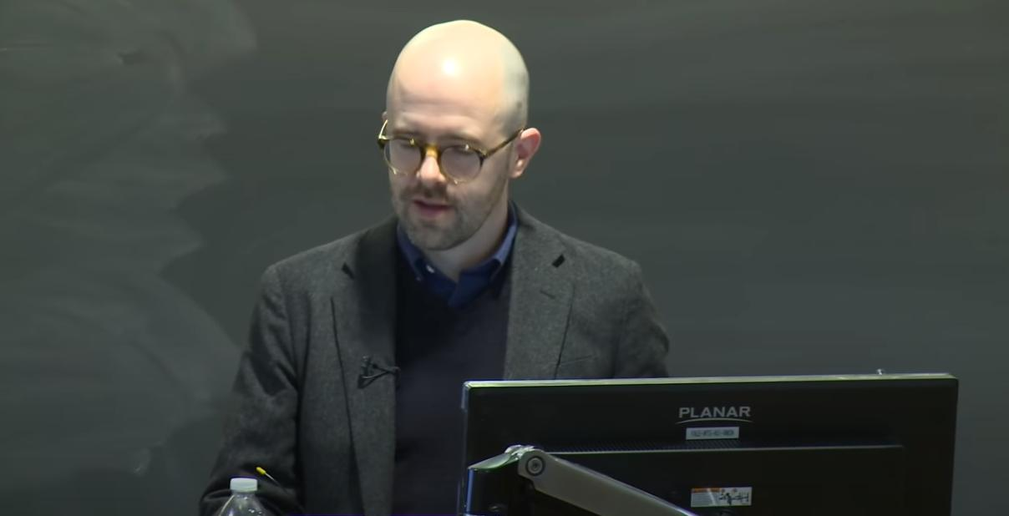
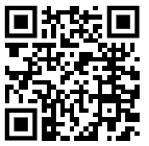
The Alignment Problem:
Machine Learning
and Human Values
with Brian Christian
https://www.youtube.com/watch?v=z6atNBhItBs

Slide 18

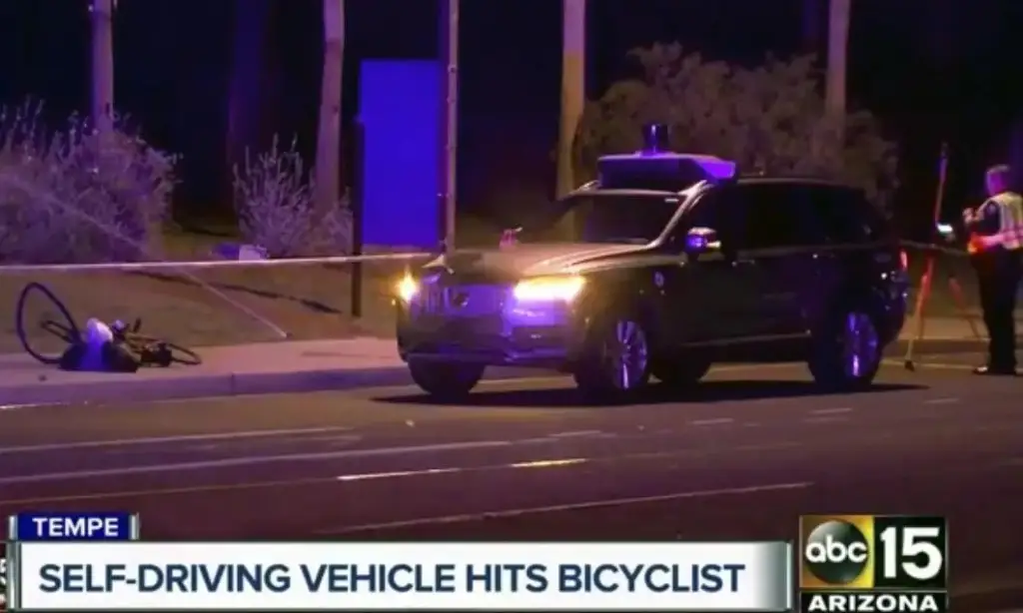
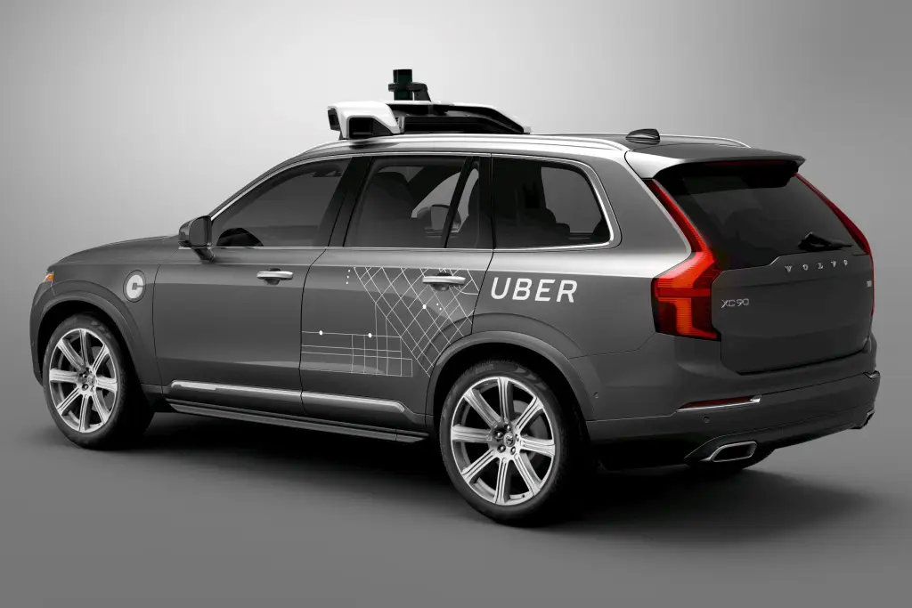
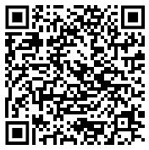
Primeira morte por um carro autônomo é culpa de humano, conclui Justiça

Slide 19
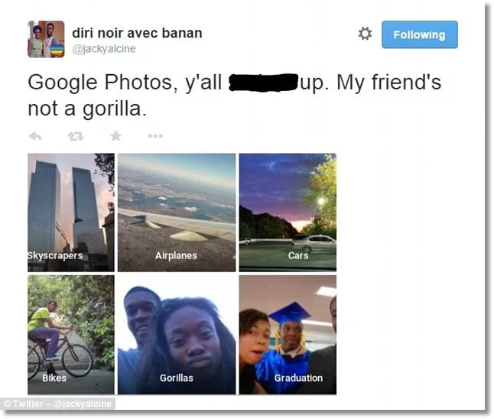
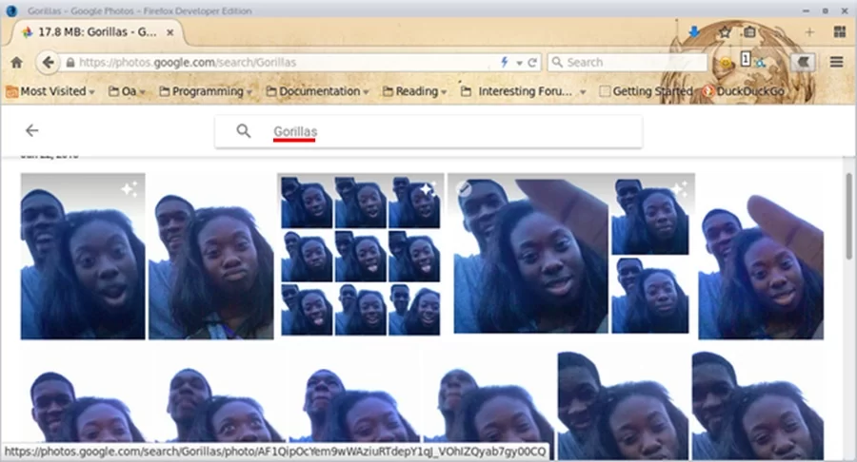
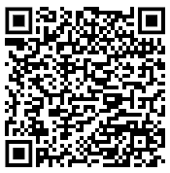
Fail épico:
sistema do Google Fotos identifica
pessoas negras como gorilas

Slide 20

DATA THAT MACHINES LEARN

Slide 21
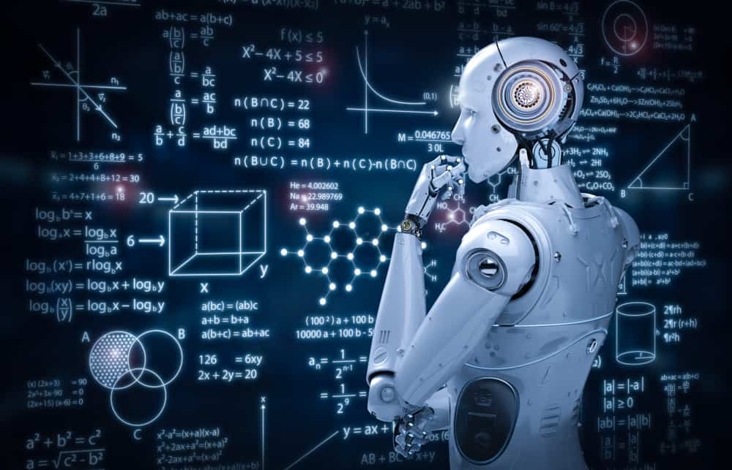
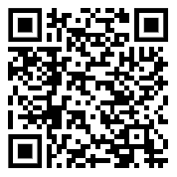
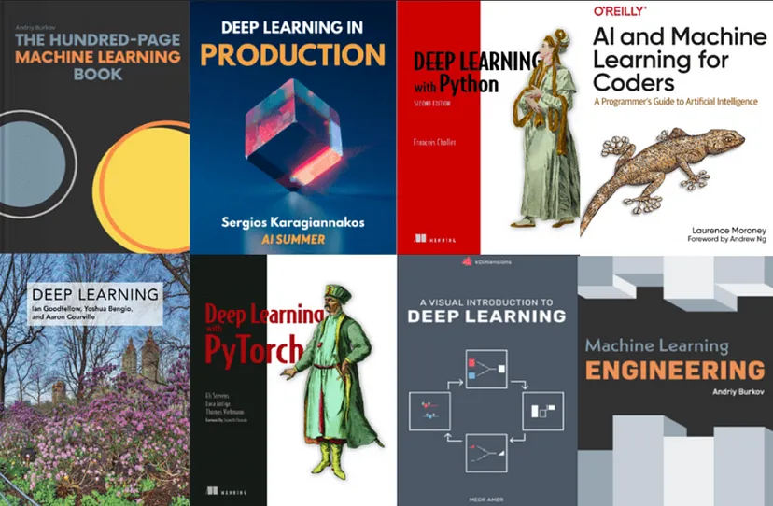
Machine Learning - Aprendizado de Máquina
https://www.datageeks.com.br/aprendizado-de-maquina/

Slide 22
BELIEF
CULTURE
RELIGION
COUNTRY
ETHIC
NENHUM DESENVOLVEDOR DEVERÁ SOFRER COM TESTES NA SUA VIDA
Artificial General Intelligence (AGI)

Slide 23

HOW TO IDENTIFY THE ERROR

Slide 24

HOW TO IDENTIFY THE
MODEL’S SUCCESS?

Slide 25

RIGHT X WRONG

Slide 26

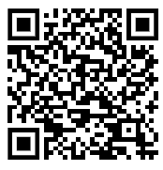
10 open source AI platforms for innovation
1. TensorFlow
2. Pytorch
3. Keras
4. Open AI
5. Rasa
6. Amazon Sagemaker
7. Apache MXNet
8. Scikit-learn
9. OpenCV
10. H2O.ai

Slide 27
What is open source AI?
Open-source AI involves freely accessible source code, fostering a collaborative environment for developers to utilize, modify, and distribute AI technologies.
This openness encourages the creation of creative AI applications as a community of enthusiasts collaborates, expediting the development of practical solutions.

Slide 28
Advantages of leveraging open source AI
Open-source AI has emerged as a powerful force in driving innovation and accessibility across various fields. Its unique characteristics offer significant advantages for developers, researchers, and organizations alike. Here’s a breakdown of the key benefits:
Diverse use cases: Open-source AI platform offers a wide array of practical applications, such as real-time fraud detection, medical image analysis, personalized recommendations, and tailored learning experiences.
Accessibility: Open-source AI projects and models are readily accessible to developers, researchers, and organizations, facilitating their widespread adoption and utilization.

Slide 29
Advantages of leveraging open source AI
Community engagement: Utilizing open-source AI provides organizations with access to a diverse community of developers who continuously contribute to the enhancement and advancement of AI tools.
Transparency and iterative improvement: The collaborative nature of open-source AI fosters transparency and facilitates ongoing improvement, resulting in the development of feature-rich, dependable, and modular tools.
Vendor neutrality: Open-source AI solutions ensure organizations are not bound to any specific vendor, offering them flexibility and independence in their technology choices.

Slide 30
Challenges associated with open source AI
While open-source AI unlocks numerous possibilities, it’s crucial to acknowledge and mitigate its inherent challenges:
Risk of misalignment and failure: Embarking on custom AI development without clear objectives can result in misaligned outcomes, wastage of resources, and project failure.
Bias in algorithms: Biased algorithms have the potential to generate flawed results and perpetuate harmful assumptions, undermining the reliability and usefulness of AI solutions.

Slide 31
Challenges associated with open source AI
Security concerns: The accessibility of open-source AI raises security concerns, as malicious actors could exploit these tools to manipulate outcomes or create harmful content.
Data-related issues: Biased training data can lead to discriminatory outcomes, while data drift and labeling errors can render AI models ineffective and unreliable.
Outsourced technology risks: Enterprises using open-source AI solutions from external sources may expose their stakeholders to risks, emphasizing the importance of cautious consideration and responsible implementation.

Slide 32
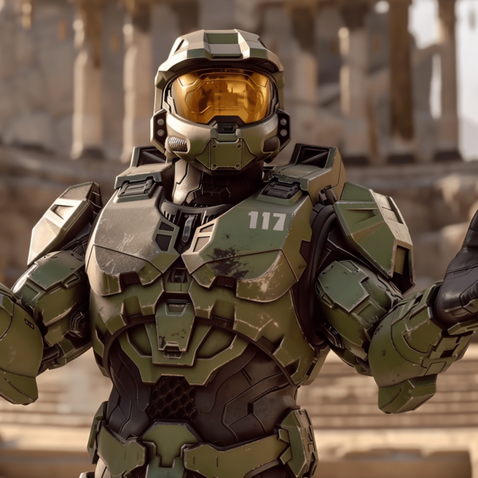
But the alignment problem
Precisely the question of how to guarantee that artificial intelligence will do what we want without being harmful and whether.
What we want is precisely what is best and if not how to prevent artificial intelligence from making that decision for us These are questions which involve not only computer scientists but medical philosophers, sociologists, economists and even physicists, chemists and biologists.
This set of questions is something that we should all be asking ourselves doing it even while using tools like chatGPT.
But we only have one chance before a path of no return how can we ensure that this chance is something we want and that our latest invention is not too the end of everything we know

Slide 33

Create Instagram Page About AI

Slide 34
About the Speaker
Q & A
Weder Mariano de Sousa
Specialist Senior Java - GFT
Technician System Development
Graduated Computer Science
https://www.linkedin.com/in/wedermarianodesousa/
Post Graduate in Midias UFG
https://github.com/weder96
Post Graduate in Information Security
https://twitter.com/weder96
https://dev.to/weder96
GOJava
AWS User Group Goiânia

Slide 35
THANK YOU

